Slide 1

Annual TPM Performance Review 14 July 2026
Notes:
Pictures can be adapted, e.g. you can take some from the project itself
1

Slide 2
Agenda
Introduction
Completeness and timeliness of records
Review of reporting processes, gaps, and improvement opportunities
Coverage and data quality
Compliance with WFP policies
Budget review, including current pressures and cost drivers

Slide 3
01
◎
01 Introduction
C4ED and the Third-Party Monitoring assignment for WFP Ethiopia

Slide 4
Introduction: The TPM Assignment at a Glance
◎
Who we are
▦
What we monitor
WFP food assistance
Live distribution and post-distribution monitoring (PDM)
Early warning, warehouse, market monitoring, livelihood and nutrition-related activities
Across Amhara, Tigray and Benishangul-Gumuz
C4ED: Center for Evaluation and Development
Independent third-party monitoring (TPM) partner

Slide 5
Year 1 at a Glance
⚙
How we work
62
Monitors deployed (3 RMCs + 2 AMCs + 60 FMAs)
3
Regions covered: Amhara, Tigray, Benishangul-Gumuz
42+
Weekly flash / hot-button reports delivered
Full reporting cadence sustained throughout the year:
✓
Weekly-to-quarterly reporting pipeline to WFP
✓
Monthly monitoring plans, narrative and expenditure reports submitted on schedule
✓
Quarterly process and outcome monitoring reports (MoDA) delivered
✓
Coordination maintained with WFP HQ, Sub/Area-Offices and
✓
Shared experiences and lessons with fellow TPM partner (JaRco)

Slide 6
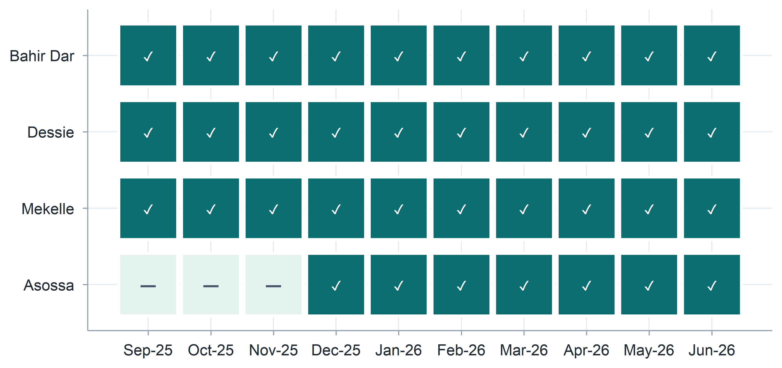
Monthly monitoring plans

Slide 7
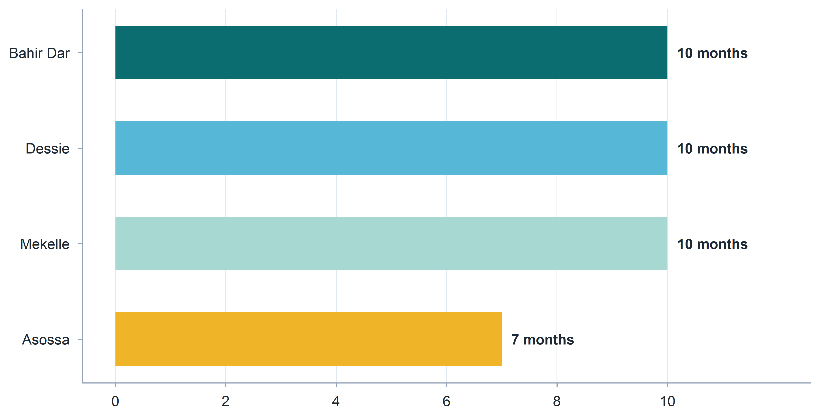
Monthly monitoring plans

Slide 8
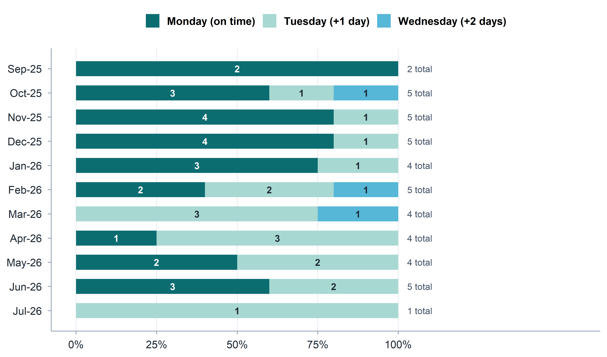
Weekly hot button/flash reports

Slide 9
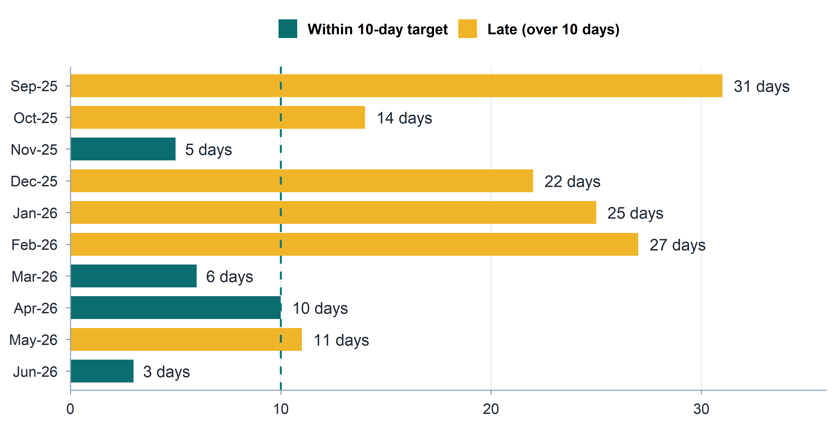
Monthly narrative and expenditure reports

Slide 10
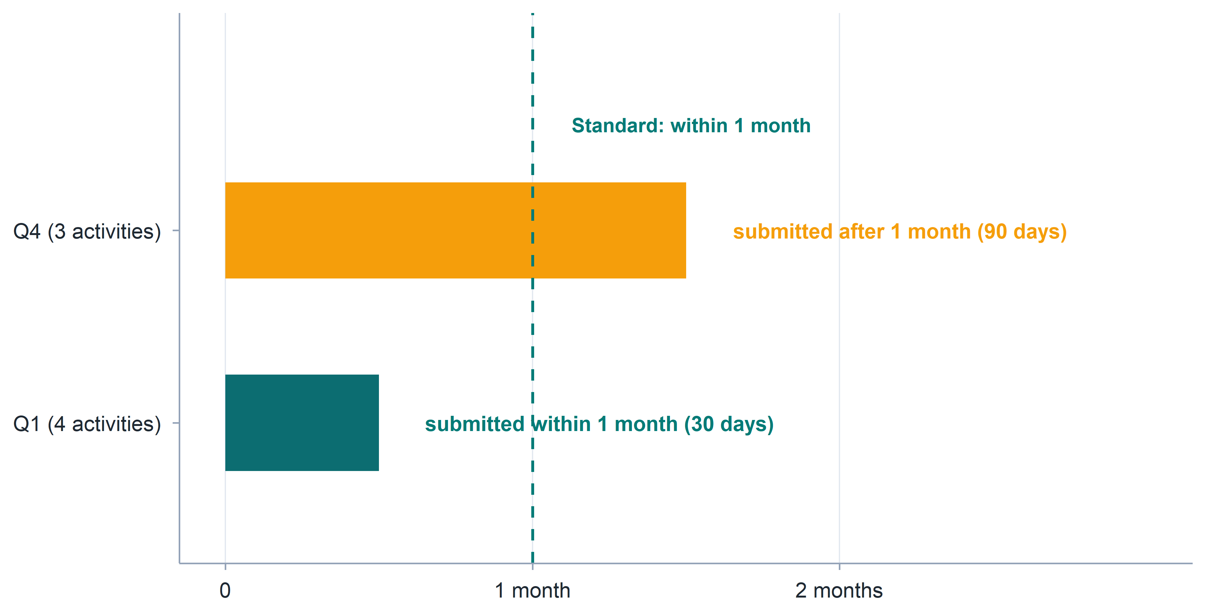
Process and outcome monitoring reports

Slide 11
Review of reporting processes
Weekly Reports: Robust collection system is well-established; compiled reports are typically submitted to WFP by Monday deadlines.
Monthly Reports: On track despite occasional late submissions. Next step is integrating FMA activity monitoring data to enhance overall reporting depth.
Quarterly Reports: Current timeline (uploads around the 8th) strains processing schedules.
Request 1: Move the WFP upload to the 2nd working day of the month.
Request 2: Increase upload frequency from quarterly to monthly. This allows rapid adaptation to checklist changes and would enable MoDA data cross-verification with FMA activity logs.
Suggestion: Can be complemented by dashboards to maximize utility.

Slide 12
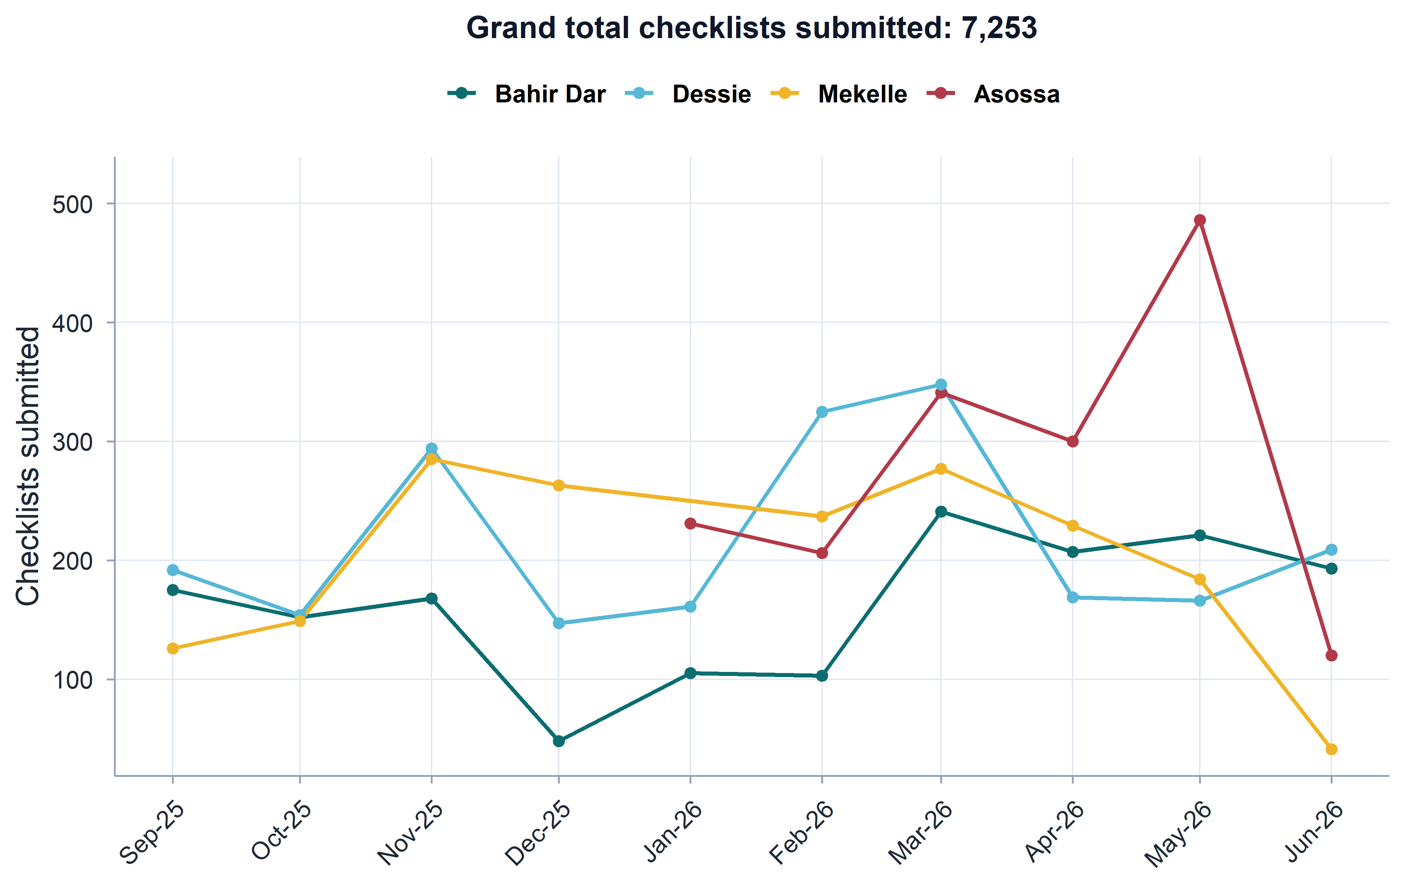
Coverage/data quality

Slide 13
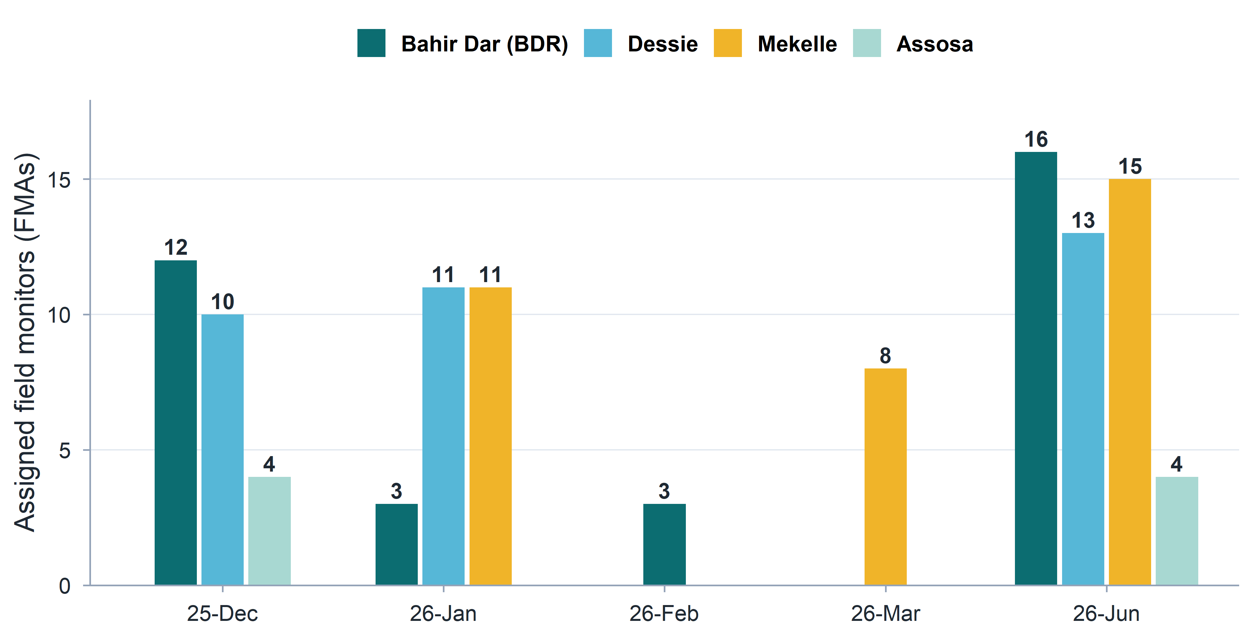
Post-Distribution Monitoring (PDM) deployments

Slide 14
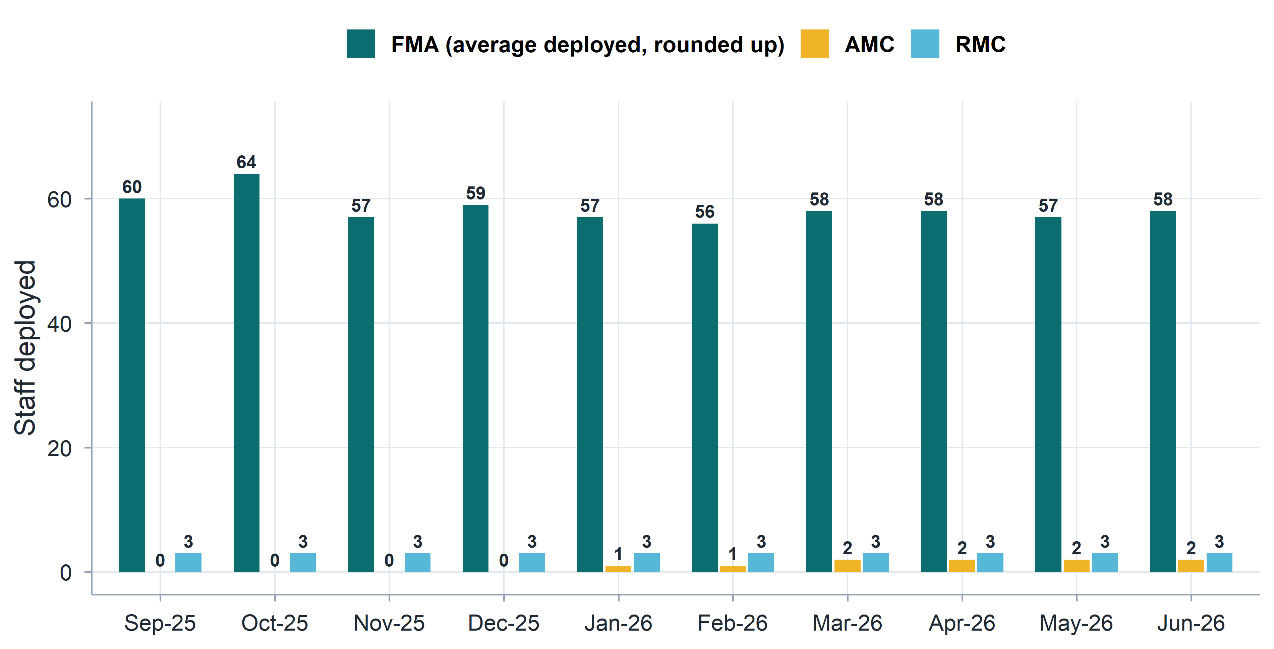
Staffing and deployment

Slide 15
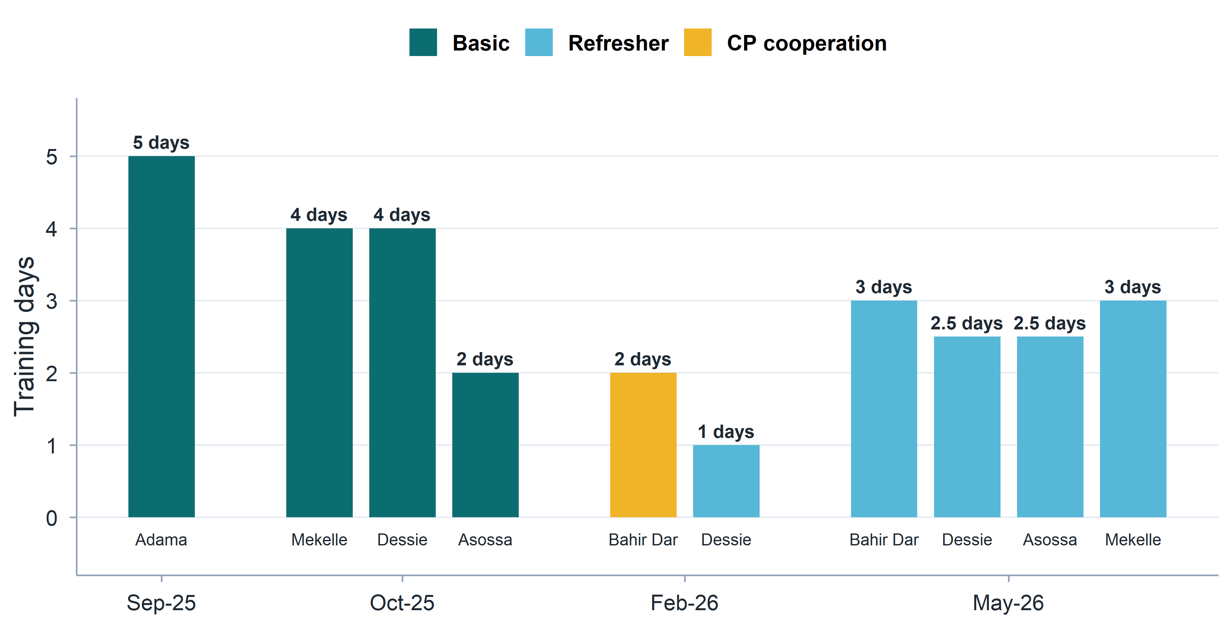
Training provided

Slide 16
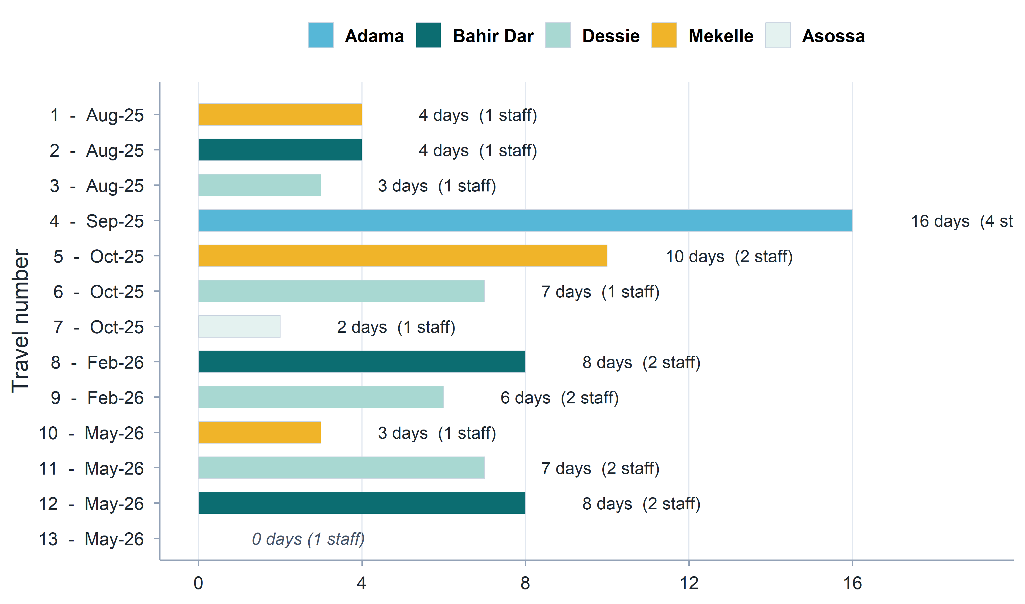
Management/support staff travel

Slide 17
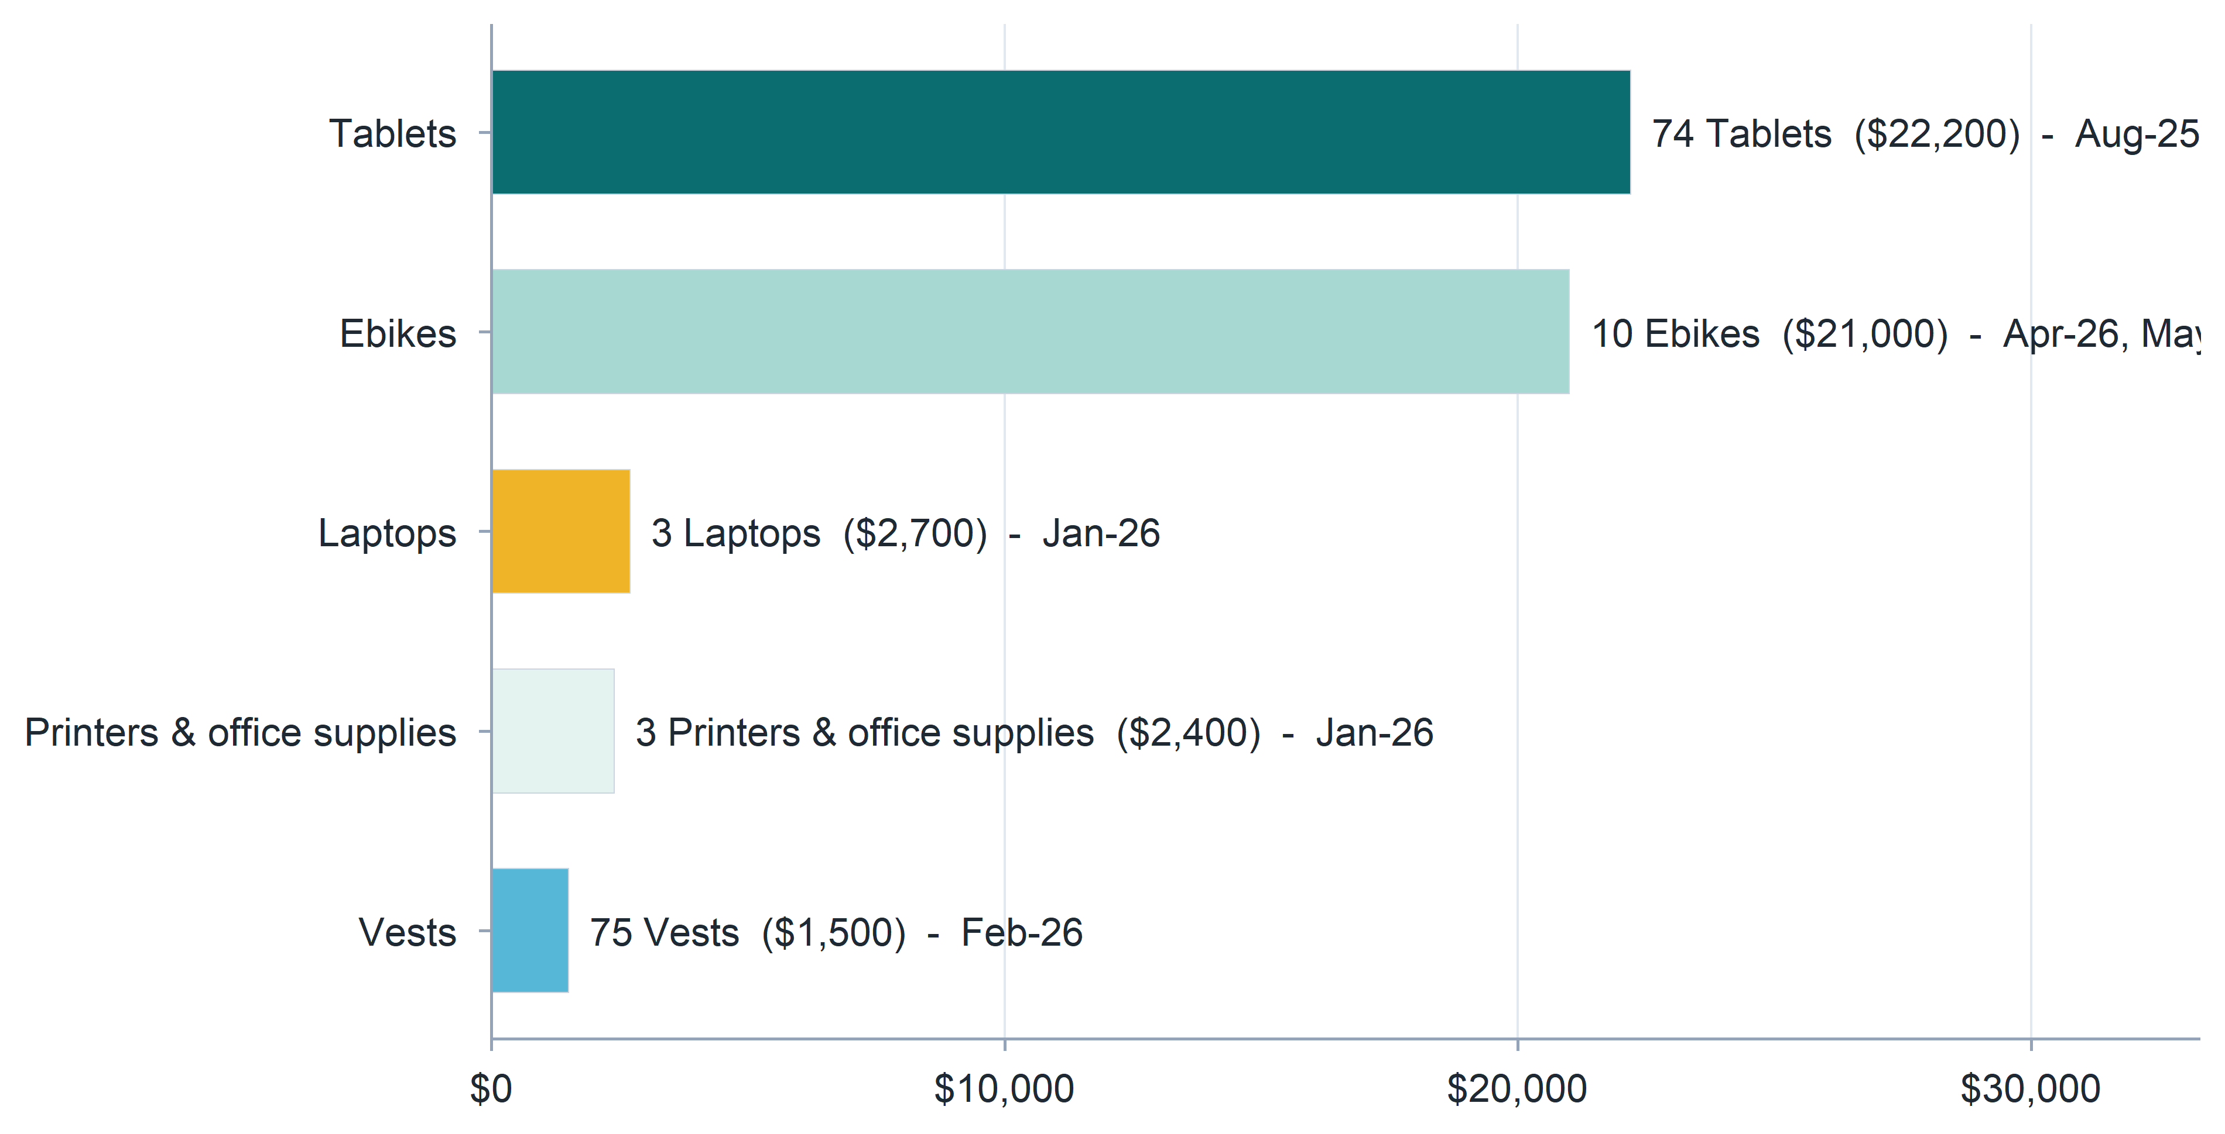
Equipment

Slide 18
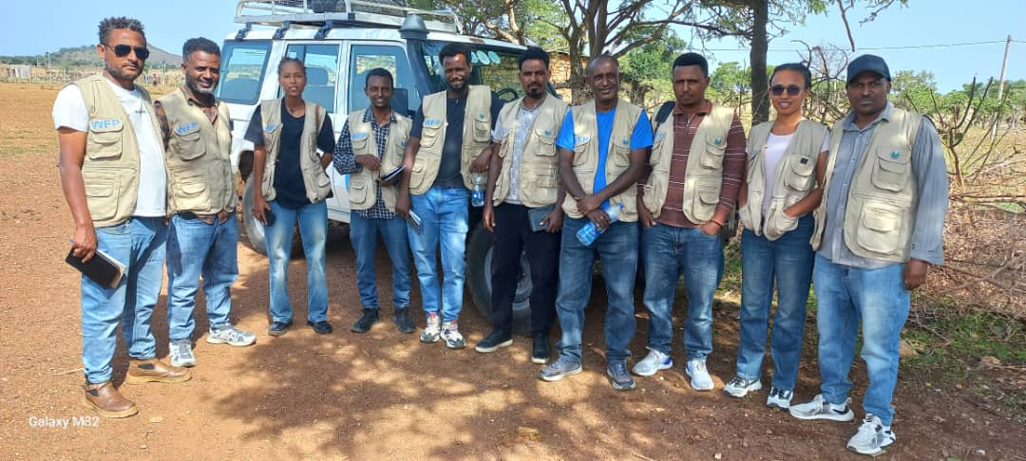
Equipment (Vests)

Slide 19
Compliance review: WFP Anti-Fraud & Anti-Corruption Policy (AFAC)
We maintain a zero-tolerance policy and strictly comply with WFP’s prohibitions against all Prohibited Practices:
Fraud, Corruption & Theft: No misrepresentation for financial/personal advantage, no offering or soliciting bribes to influence actions, and zero tolerance for unauthorized taking of property.
Collusive & Coercive Practices: No anti-competitive arrangements or improper behavior targeted at influencing WFP or other parties, and no use of threats, harm, or intimidation.
Obstructive Practices: Full cooperation with official investigations - no destroying, altering, or concealing evidence, making false statements, or impeding WFP’s contractual access to information.
Financial Integrity: Absolute prohibition of Money Laundering (concealing illicit funds) and the Financing of Terrorism (providing resources to any individuals or entities on the UN Security Council Consolidated List).

Slide 20
Compliance review: WFP Anti-Fraud & Anti-Corruption Policy (AFAC)
Integrity and Accountability:
FMA (few) claim activity despite facts
Potential issues with transport reimbursement and overnight per diem
In case of dismissal, we sometimes face issues with non-returned tablets (disciplinary issues and legal advisor on HR)
Independence: Rotation enforced − to keep monitors alerted and to counter the risk of Corruption and Collusive Practices
Professional Skepticism: High due to large volume of flagged issues (absence of evidence of Obstructive Practices)
Theft: For example, consumption of WFP nutrition products.
Sensitization of monitors through training and clear communication by Regional and Area Monitoring Coordinators

Slide 21
Compliance review: Prevention of Sexual Exploitation and Abuse (PSEA)
We strictly commit to WFP’s zero-tolerance policy regarding sexual exploitation and abuse, ensuring full alignment with UN standards and contractual mandates:
Internal Policies in Place: We have established rigorous internal PSEA policies and behavioral standards matching the ethical expectations of WFP’s Code of Conduct.
Active Awareness Measures: We undertake continuous organizational awareness training to ensure all personnel fully understand, prevent, and uphold these mandatory standards.
Accountability & Action: We maintain strict mechanisms to prevent misconduct, immediately investigate any allegations, and implement rapid corrective actions.

Slide 22
Compliance review: Data protection
We comply with all data processing, transmission, and privacy mandates as the Processor:
Authorized Processing & Purpose: We process Personal Data strictly under WFP’s written instructions, solely for agreed purposes, with no independent business use or proprietary claims.
Secure Data Transfer: All data transfers utilize 128-bit AES encryption via secure email or SFTP using compliant formats (CSV, XML, JSON).
Operational Transparency & Auditing: We maintain a detailed record of all processing activities available for WFP review and will immediately flag any violating privacy rules.
Strict Third-Party Restrictions: No data sharing or third-country/cloud transfers without explicit, prior written authorization from WFP.
90-Day Data Retention Limit: All Personal Data are securely deleted/destroyed from all physical and digital systems within 90 days of acquisition (or upon request).

Slide 23
Compliance review: Information security
We comply with all requirements of the WFP Information Security Policy as the Processor:
Security Framework: Maintain an active information security program aligned with industry standards.
Data Protection & Encryption: Enforce full multifactor authentication (MFA), end-to-end encryption for all data (at rest, on mobile/storage devices, and in transit), and daily backups.
System Resilience: Guarantee confidentiality, integrity, and availability with established protocols for regular testing, risk-based data governance, and rapid restoration in the event of an incident.
Access Control: Maintain strict physical and logical access controls, including managed user lifecycles, administrative privilege tracking, and segregation of duties.
Audit & Alignment: Subject to WFP security reviews/audits and written approval for any core system changes.

Slide 24
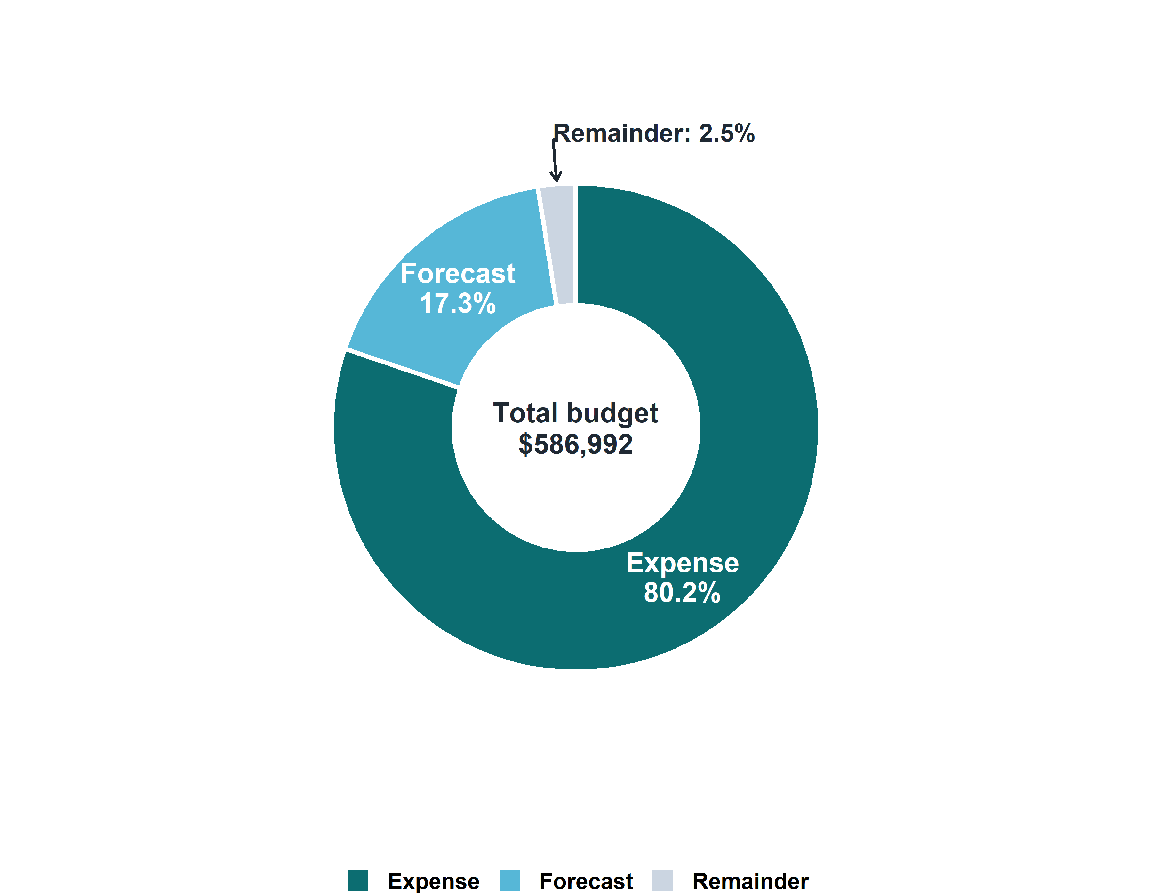
Budget review

Slide 25
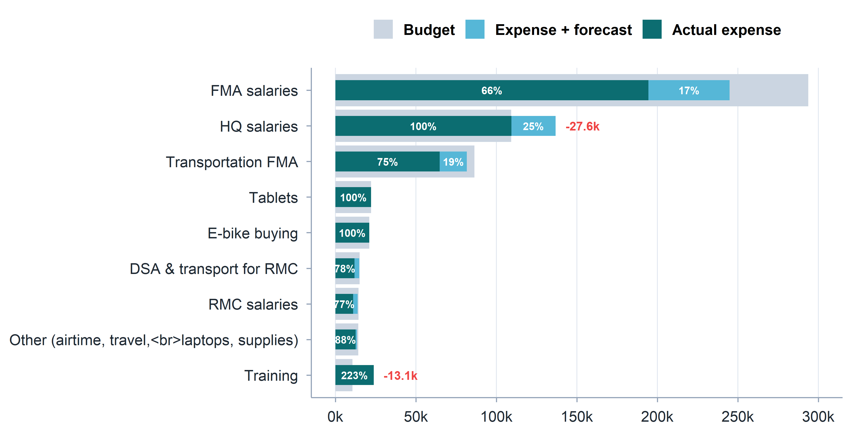
Budget review: amounts

Slide 26
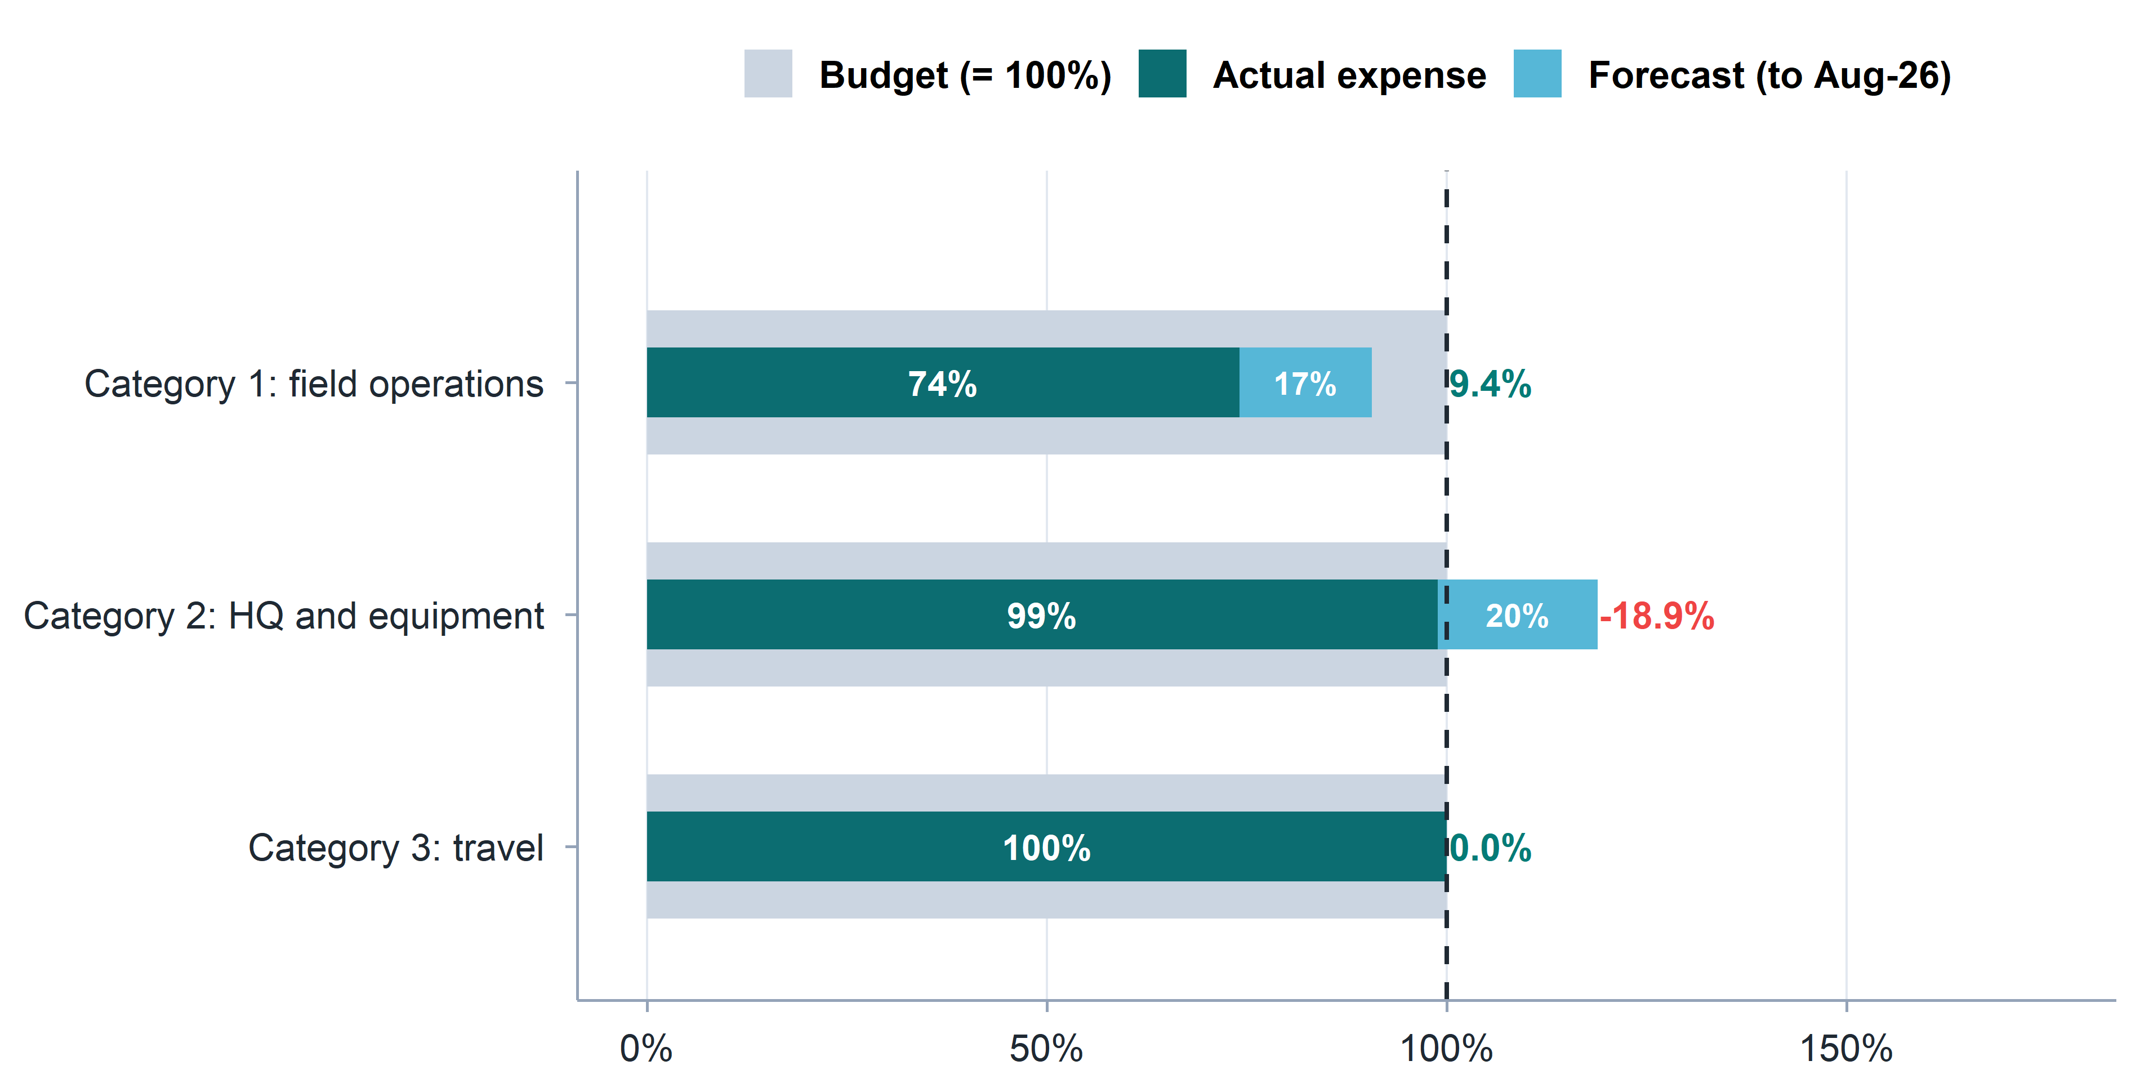
Budget review: by category (%)

Slide 27
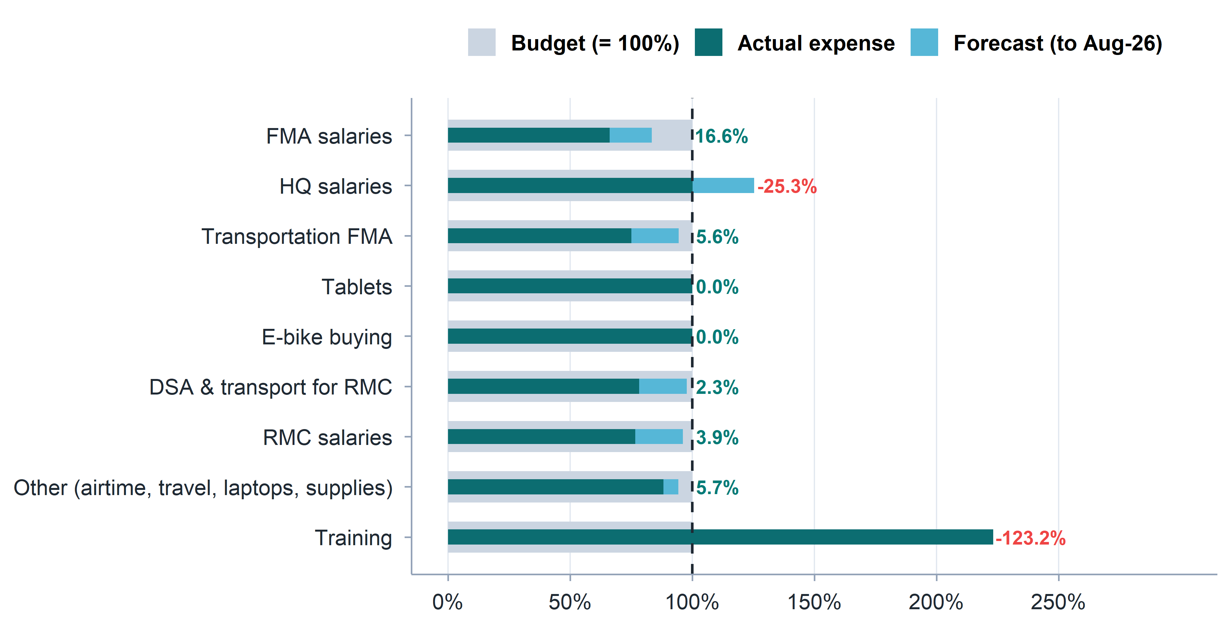
Budget review: by line item (%)

Slide 28
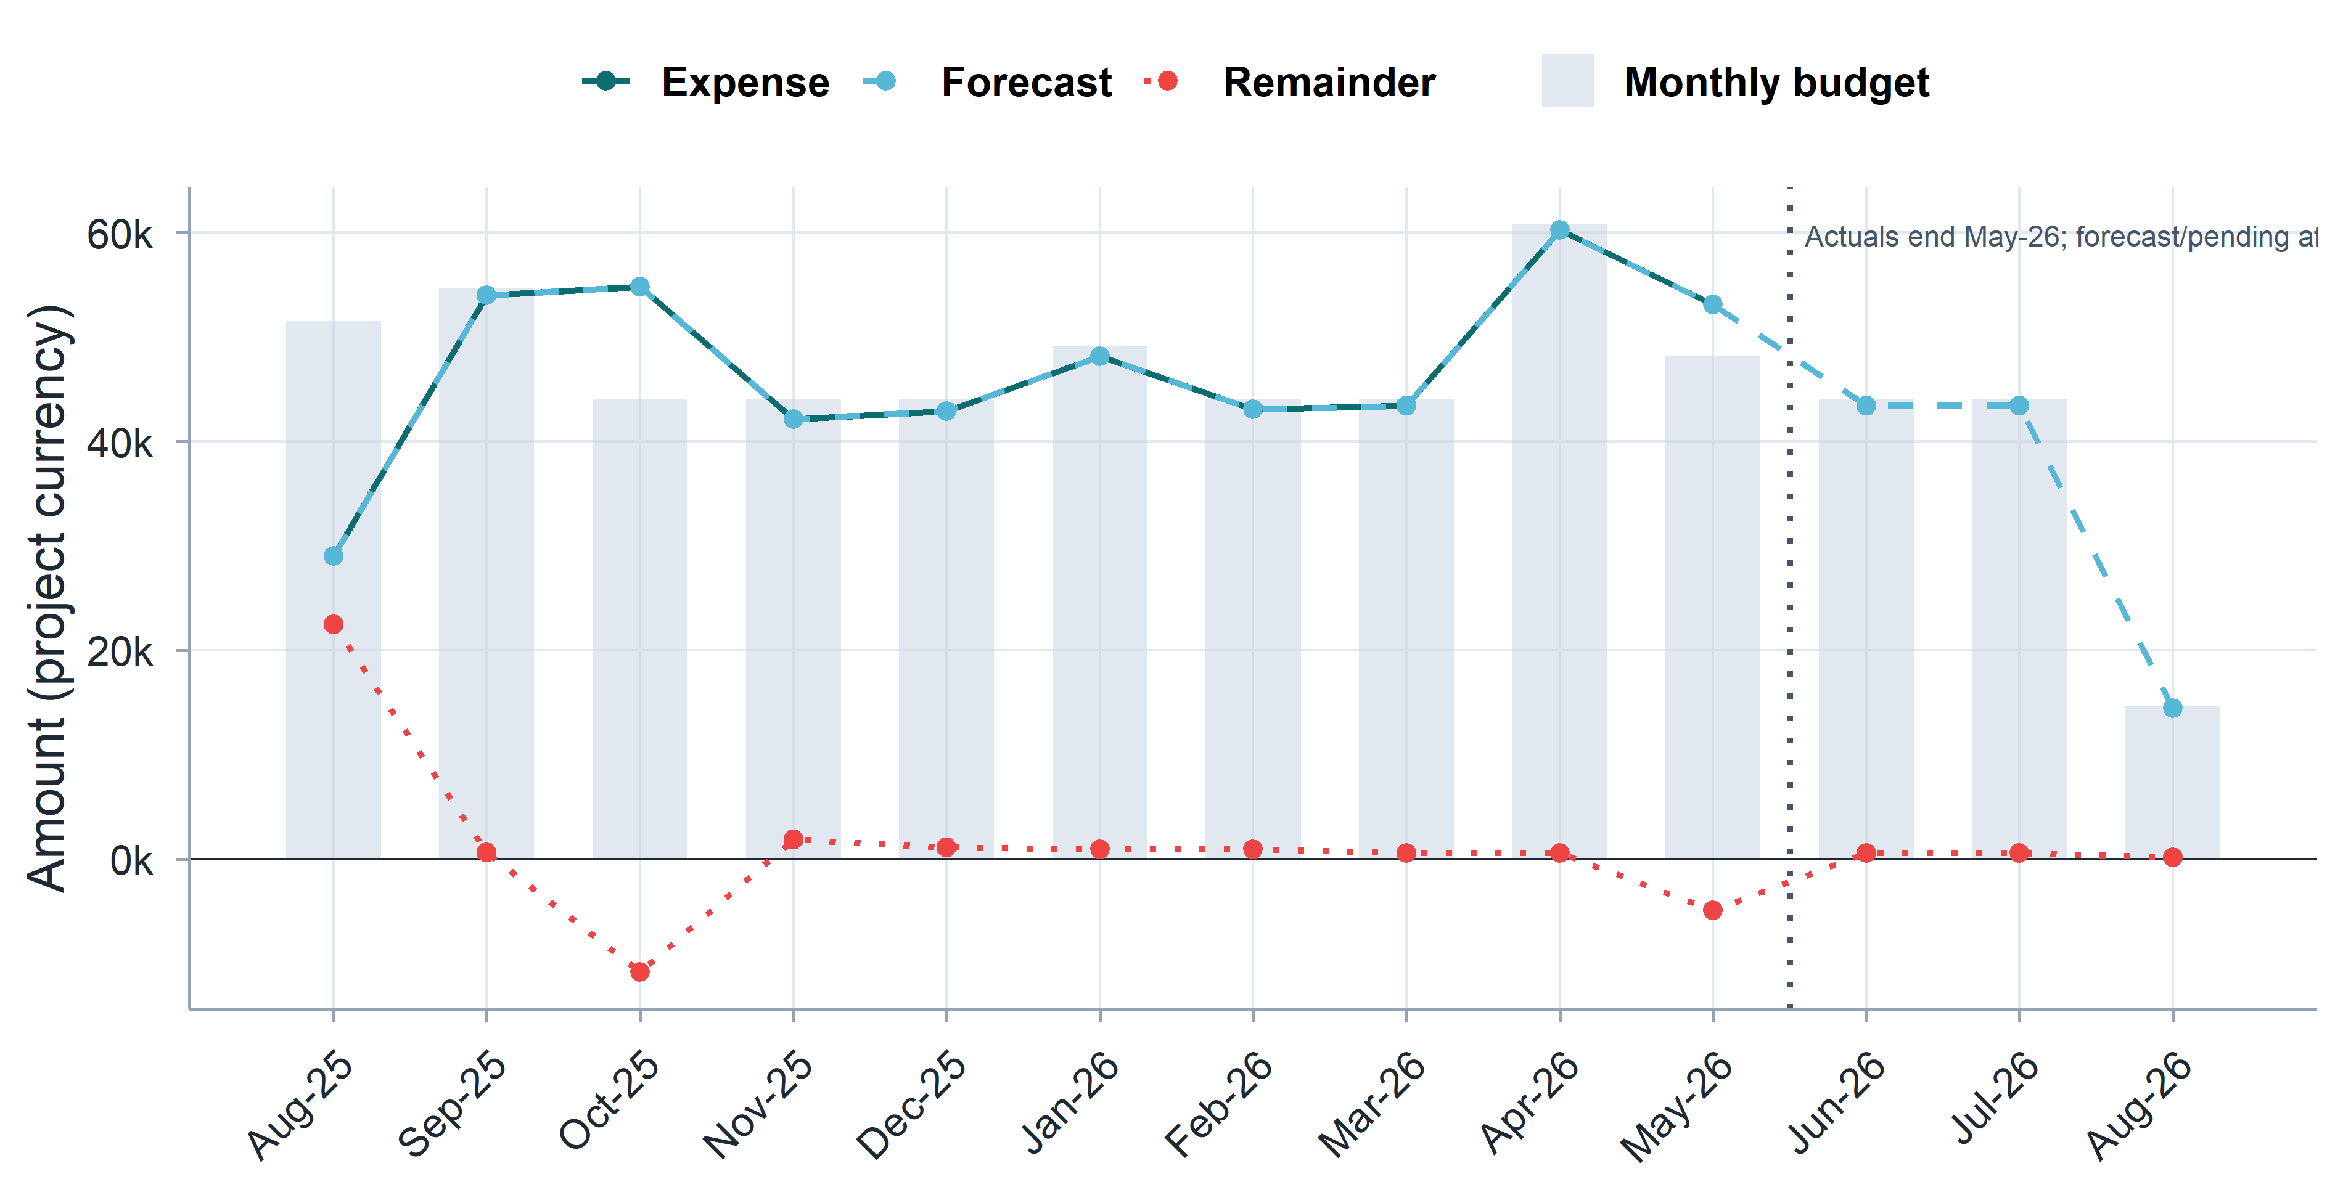
Finance review

Slide 29
Budget review: Current pressures and cost drivers
Transportation & Mobility: Rising fuel costs, local shortages, and regional transport constraints severely impact field efficiency. While (a limited number of) motorcycles assist monitor teams, current transportation provisions require a strategic review.
DSA Alignment: Current overnight Daily Subsistence Allowance (DSA) rates are outdated and need adjustments to reflect the increased cost of living and prevailing regional market conditions.
Compensation: Raised by TPM staff during trainings and review meetings, compensation packages are under pressure and need to be reviewed to ensure retention and motivation.
Uneven/Expanded Scope: Originally budgeted for mostly process and basic output/outcome monitoring, monitors are managing complex tasks (Outcome Monitoring, PDM, Early Warning, and market assessments).
Staff Capacity Deficits: In Tigray, insufficient staff due to the reduction from 23 to 15 FMAs. Currently, an overwhelming workload across multiple parallel surveys and process monitoring might compromise data quality and regional coverage.

Slide 30
Thank you

